Slide 1
Understanding & Preventing Phishing Attacks
Protecting Yourself from Online Bait

Slide 2
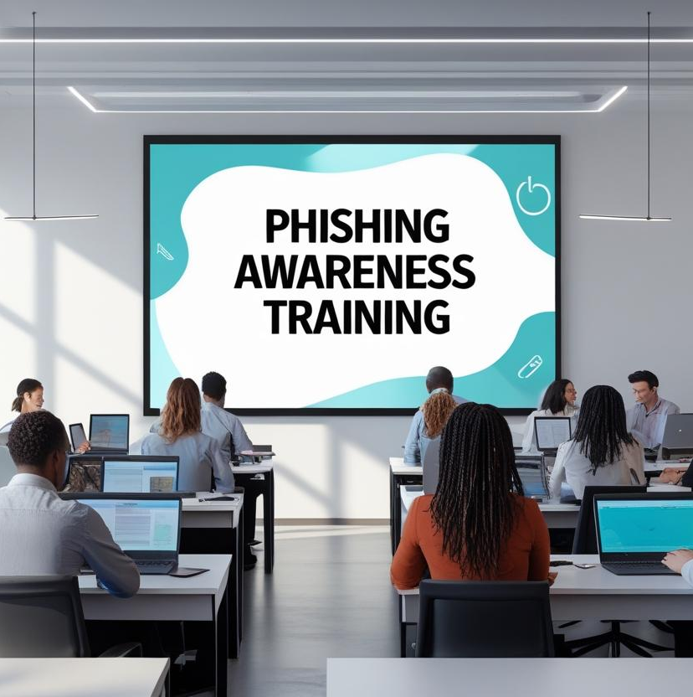
Welcome to the Phishing Awareness Module
Learning Objectives:
Understand what phishing is and how it works
Identify different types of phishing attacks
Recognize signs of phishing emails, fake websites, and suspicious messages
Learn how to protect yourself and your organization from these threats

Slide 3

What is Phishing?
Phishing is when cybercriminals pretend to be someone you trust to trick you into sharing sensitive information like passwords, bank details, or personal data.
Common goals:
Steal passwords or personal data
Spread malware
Gain access to company systems
Delivered through:
Email (most common)
Text messages (Smishing)
Phone calls (Vishing)
Social media messages

Slide 4
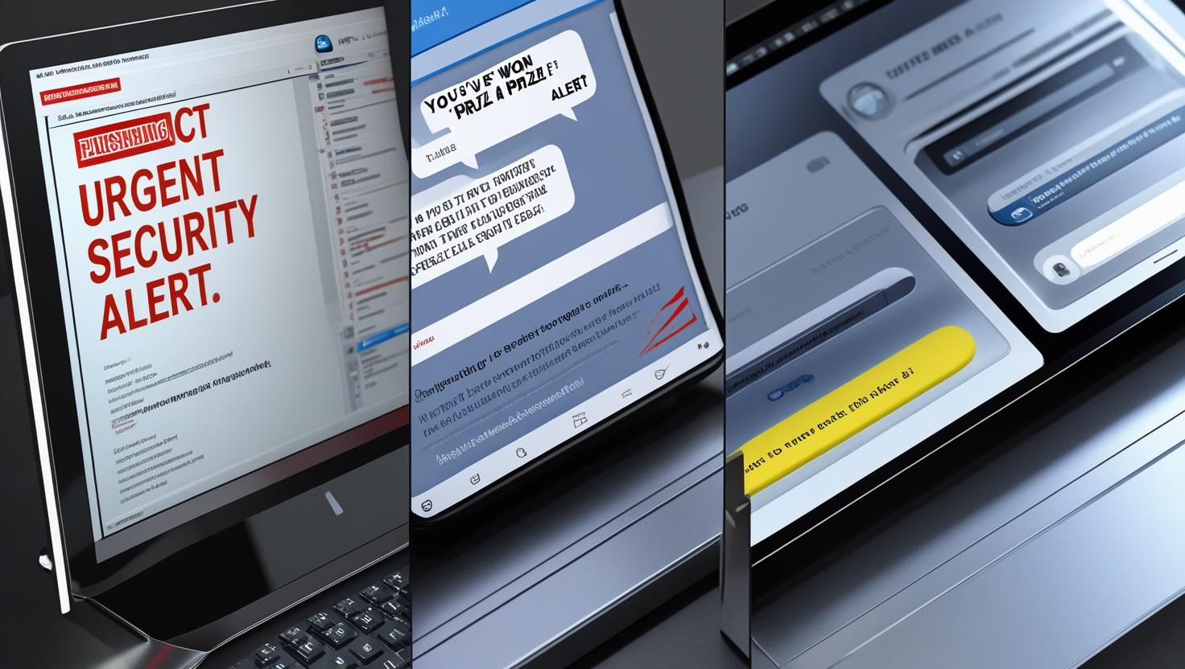
Real-World Examples
Examples are:
Email Scam: “Your account has been compromised. Click here to verify.”
SMS Scam (Smishing): “You’ve won a prize! Reply with your bank info.”
Social Media Scam: “Is this you in this video? [malicious link]”

Slide 5
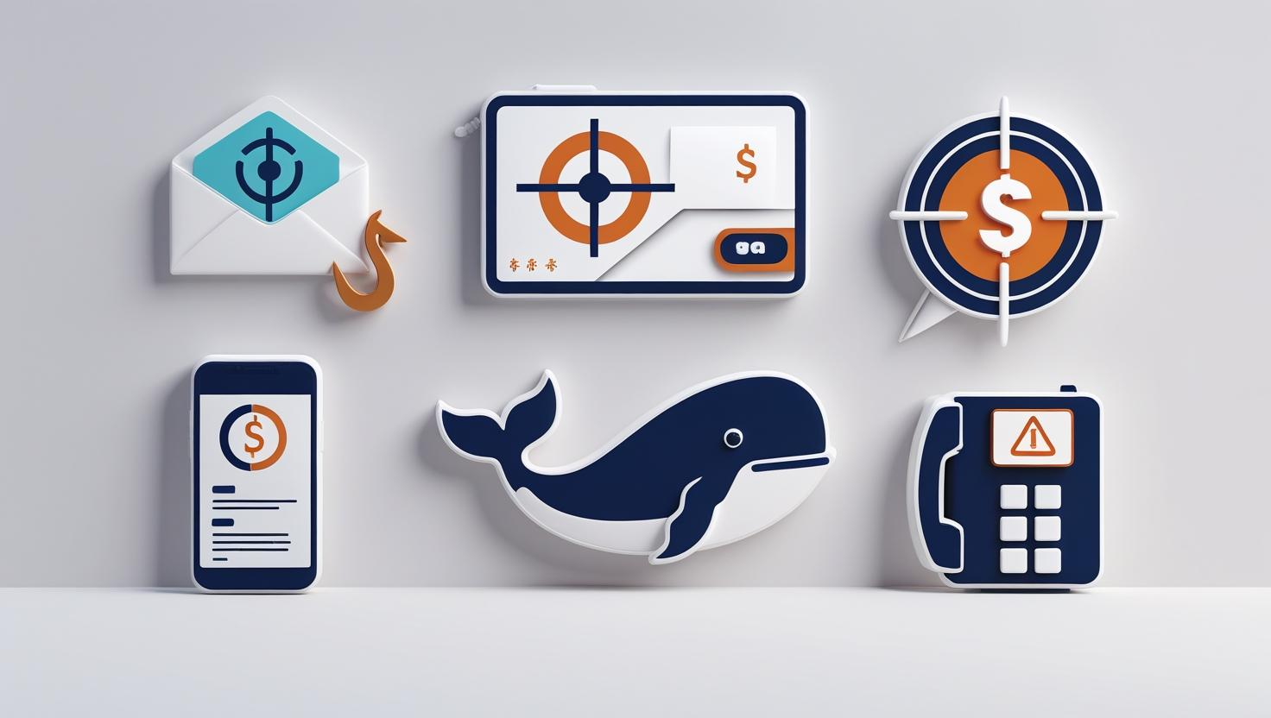
Types of Phishing
Email Phishing
Spear Phishing (targeting specific people)
Whaling (targeting executives)
Smishing (via SMS)
Vishing (voice phishing)
Clone Phishing (copy of real message with malicious twist)

Slide 6
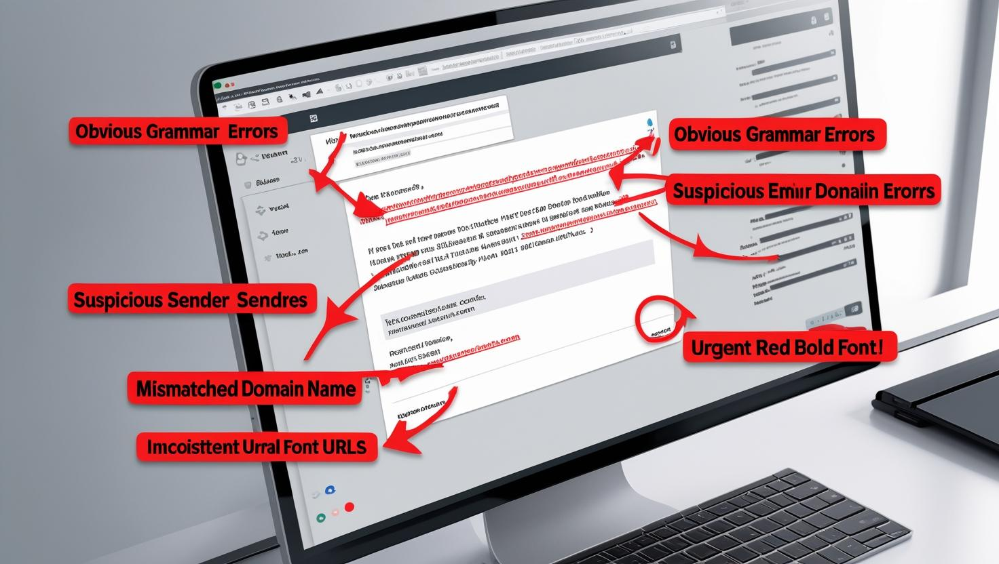
Spotting a Phishing Attempt
Red Flags Checklist:
Spelling/grammar mistakes
Urgent or threatening tone (“Act now!”)
Strange or misspelled email address
Suspicious links or unexpected attachments
Requests for sensitive info (passwords, PINs, OTPs)

Slide 7
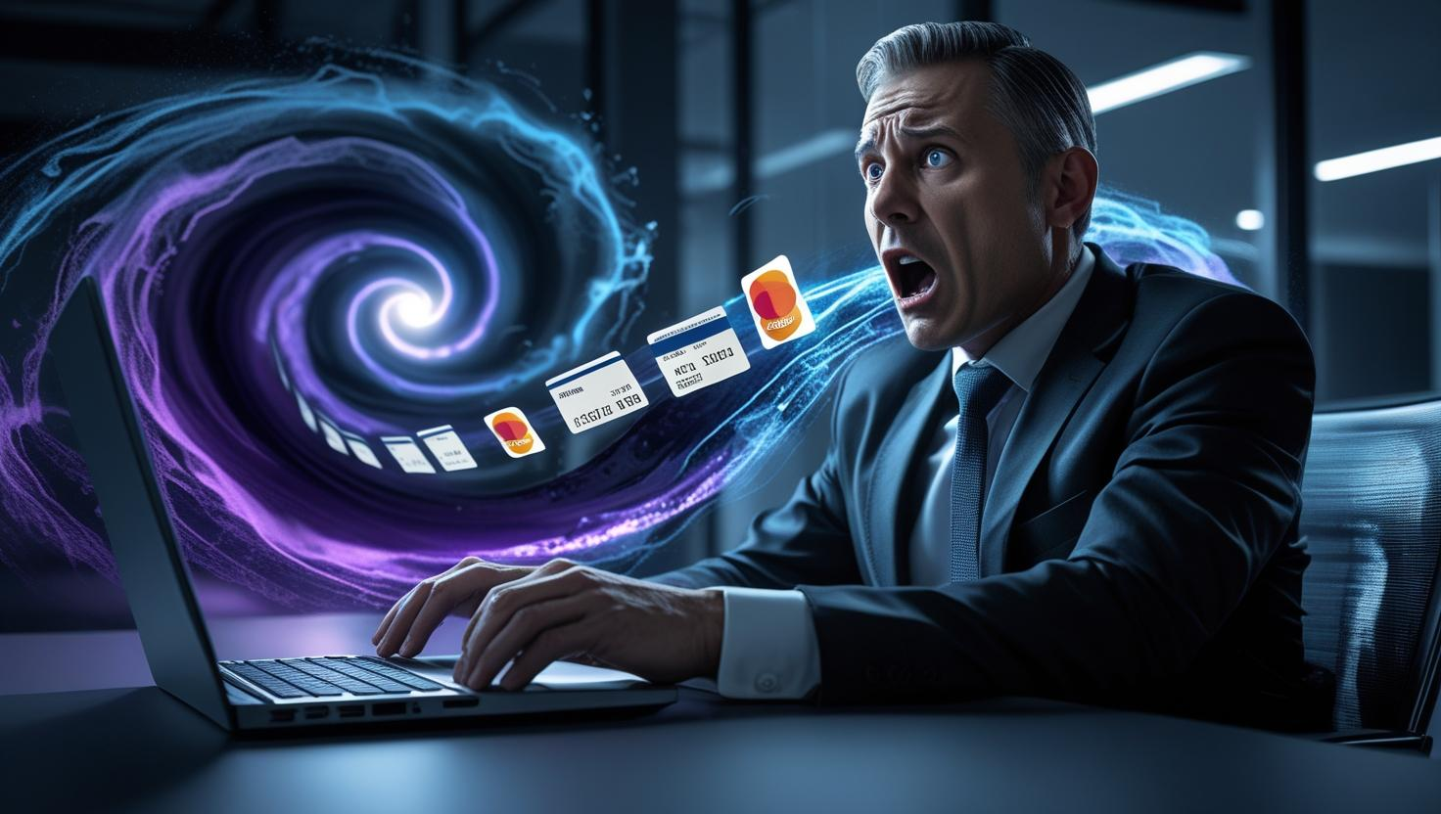
Consequences of Falling for Phishing
Identity theft
Data breach
Financial loss
Malware infection
Reputation damage

Slide 8

How to Protect Yourself
✅ Best Practices:
Never click suspicious links
Use Two-Factor Authentication (2FA)
Keep devices/software updated
Report suspicious messages to IT/security
Don’t share personal info over email or SMS

Slide 9
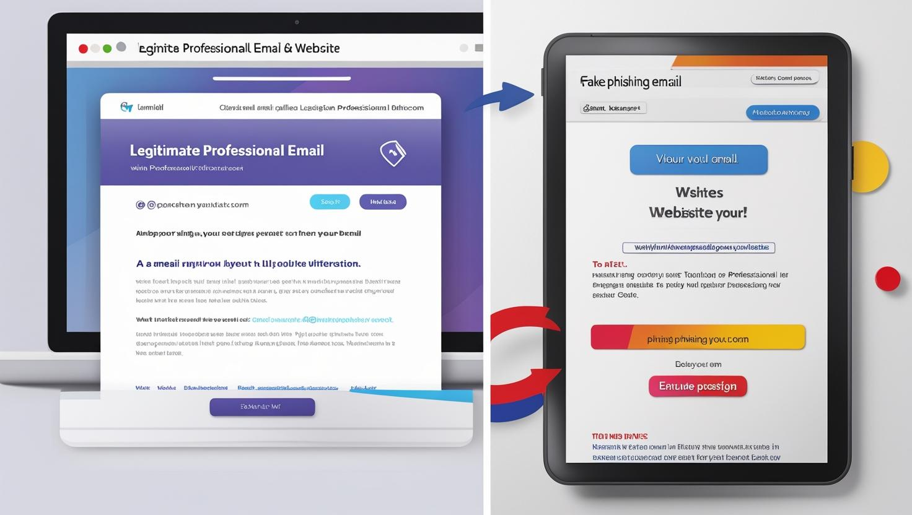
Recognizing Fake Websites
Phishing Email Red Flags:
Sender address looks off (e.g., codealpha1.tech instead of codealpha.tech)
Typos or strange wording
Scary or urgent messages
Suspicious links, hover before clicking
Requests for passwords, PINs, or OTPs
Fake Website Clues:
Slightly misspelled URLs
No security padlock or “https” missing
Poor design and broken links
Avoid clicking email links, type the address yourself

Slide 10

Social Engineering Tactics
How hackers manipulate people, not machines:
Phishing – Fake emails/messages
Pretexting – Pretending to be authority (HR, IT)
Baiting – Tempting offers (infected USB drives)
Tailgating – Slipping into secure areas
Vishing – Voice phishing calls
Smishing – Fake SMS messages

Slide 11

Best Practices to Stay Safe
✅ Think before you click – Slow down when an email feels “off” ✅ Verify requests – Call or message the person directly ✅ Check the sender’s address carefully ✅ Use strong, unique passwords + a password manager ✅ Enable multi-factor authentication (MFA) ✅ Report suspicious emails to your IT/security team

Slide 12
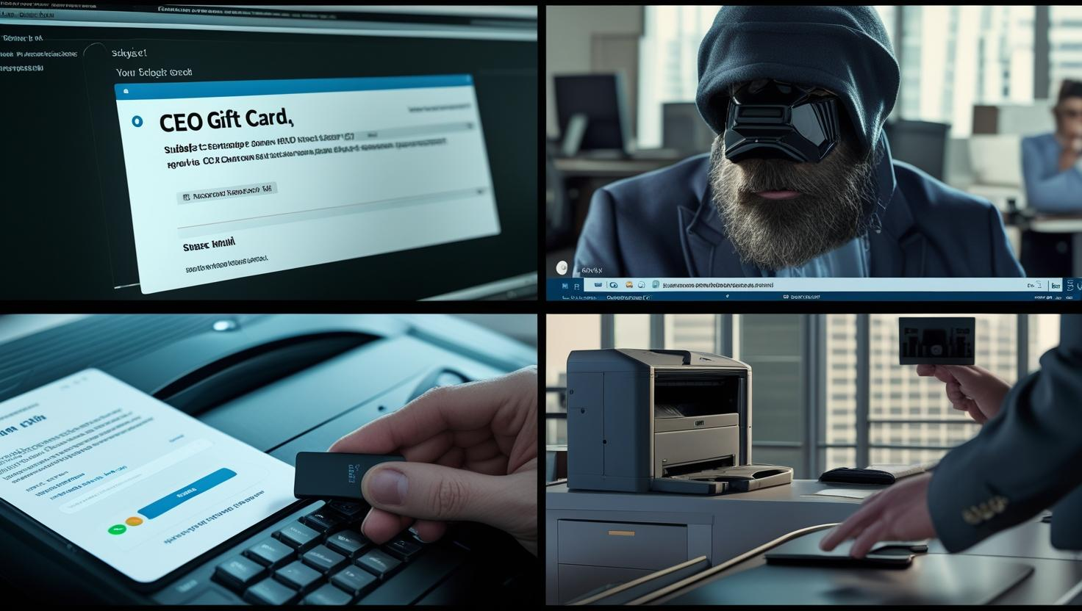
Real-World Cases
Example 1 – Fake CEO Gift Card Request An intern got an “urgent” email from the “CEO” asking for ₦200,000 in iTunes gift cards. Red Flags: Urgent, personal email address, unusual request.
Example 2 – Fake Microsoft Login Page Email claimed unusual login activity, linked to login-micros0ft.com. Red Flags: Misspelled domain, generic greeting, urgent tone.

Slide 13
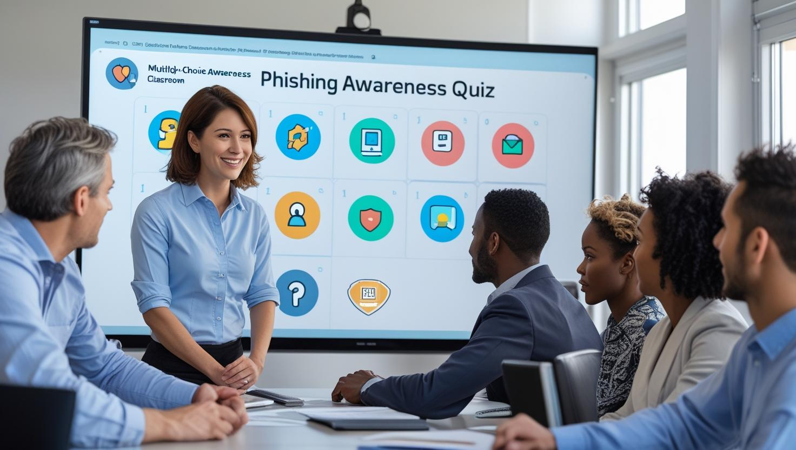
Quick Quiz (Interactive)
Question 1: You receive an email from support@paypall.com asking you to reset your password. What’s your first move?
A) Click the link and reset immediately
B) Ignore and delete
C) Hover over the link, verify the sender, and go to PayPal’s official site manually
Question 2: A “CEO” emails you to urgently transfer money for a client deal. What’s the best action?
A) Approve quickly, it’s urgent!
B) Call the CEO or finance team to confirm before acting
C) Forward it to everyone for awareness

Slide 14
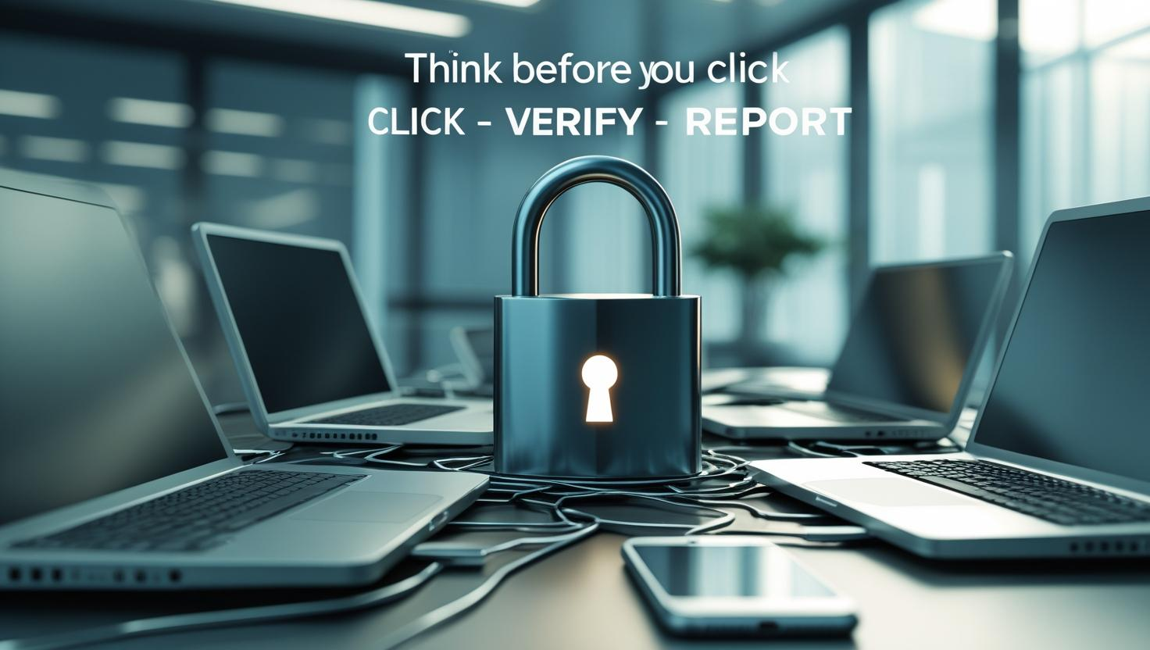
Closing & Key Takeaways
Think before you click
Verify before you trust
Report before you delete
Remember: Cybersecurity is everyone’s job

